Slide 1

Hayelni.ai
Supervised by : Dr Khaled elsheshtawy

Slide 2
Welcome
Let’s Start !

Slide 3

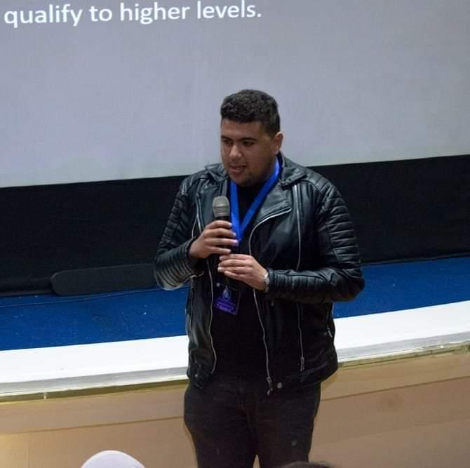


OUR TEAM
Jan Youssef
Mohamed Ayoup
ID : 89477 Java Backend Developer
ID : 89402 C# Developer
Beshoy Samir
Mohamed Tarek
ID : 89534
AI/Data Science Engineer
ID : 89610
Front end Developer

Slide 4
Agenda
1 - Introduction
2 - Possible Beneficiaries
3 - Motivation
4 - Main Objectives
5 - SDG’s Goal
6 - Related Works
7 - Problem Definition
8 - Proposed System
9 - System Architecture
10 - Methodologies and Techniques
11 - System Requirements (S/W and H/W Tools)
12 - Results and Outcomes
13 - System Validation
14 - Conclusion
15 - References

Slide 5

Once upon a day, there was a loving family living together, consisting of a father, a mother, and two children.

Slide 6

The father worked diligently every day as a builder and was the sole provider for the family.

Slide 7
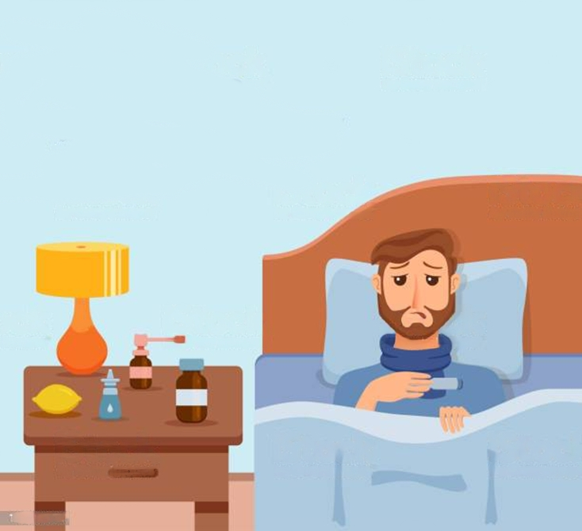
one day, he fell ill and found himself confined to his bed And has breathing problems.

Slide 8

Desperate for answers, the father visited the doctor to determine the cause of his illness. The doctor requested x-rays on his chest to investigate the underlying condition.

Slide 9
After the doctor examined the x-rays, she told the patient that he did not suffer from any health problems in the lung.

Slide 10
Unfortunately, the father's health continued to deteriorate, and his condition grew increasingly severe.

Slide 11
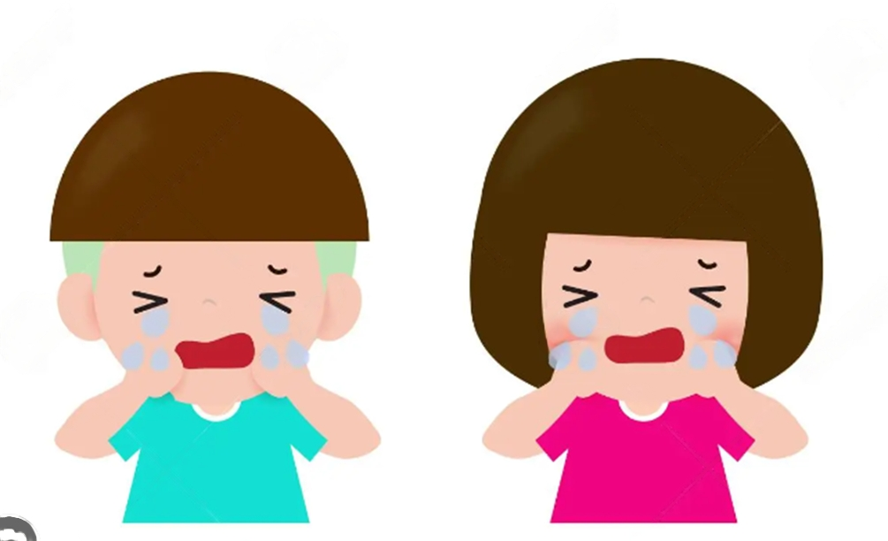
And his children became sad and afraid for their father :(

Slide 12
Challenges
The doctor is unable to accurately ascertain whether the patient is indeed suffering from the disease.
Assess the severity of the patient's condition to prioritize their treatment.
There is a high percentage of error in detecting the disease.

Slide 13
02
Possible Beneficiaries

Slide 14
Possible Beneficiaries
1 – Doctors
2 – Patients
3 – Health Organizations

Slide 15
03
Motivation

Slide 16
Motivation
Our motivation for this project is to address the global shortage of trained radiologists [1], specifically in Egypt, which faces a steep increase in healthcare prices and a decline in availability especially for low-income Egyptians. Our objective is to create an AI model which is capable of classifying Chest X-Rays into those positive for Pneumonia and those negative, with a higher focus on sensitivity or the “true-positive rate”, as recommended by the WHO [2], these guidelines were chosen because the highest chances of saving lives through detecting cases which are very likely to be positive. Our methodology consisted of dividing the data into 80% for training, 10% for testing, and 10% for validation, following that we tuned our model to give equal weights to each of the RGB channels in the image, as we found one channel tended to dominate the others. During the training, the model was instructed to learn much more heavily from the negative cases, as our data was comprised of 90% positive cases and 10% negative cases which was biasing the model towards the positive case. We found that our model achieved ~88% accuracy, compared with [3] which achieved 76.4% on the same dataset. This was accomplished with minimal training on the free tier provided by the Kaggle platform, further fine-tuning may be possible with better hardware.

Slide 17
04
Main Objective

Slide 18
Main Objective
Details

Slide 19
05
SDG’S Goal

Slide 20
SDG’s Goal
Details

Slide 21
06
Related Works

Slide 22
Study | Published on | Dataset | Algorithms used | Accuracy
Hayelny | 2022-23 | 5,863 Chest X-ray images | Channel-wise normalization Weighted loss function Weight decay Learning scheduler Data Augmentation CNN Architecture: Resnet18 | 88%
[4] | December 2020 | Montgomery dataset (138 images) Shenzhen dataset (662 images) | Canny Algorithm [13] | 93.59%

Slide 23
Study | Published on | Dataset | Algorithms used | Accuracy
[5] | July 2021 | 3000 images for normal chest X-rays were selected from different public image databases. 623 chest X-ray COVID-19 images were collected from the GitHub repository, expanded to 2000 by image augmentation | VGG16 [14] ResNet50 [15] InceptionV3[16] Transfer learning [17] | >98%
[7] | Jan 2021 | 6749 two-view chest radiographs | Resnet18 pre-trained with ImageNet CNN | 74%

Slide 24
Study | Published on | Dataset | Algorithms used | Accuracy
[6] | May 2021 | 550,297 images | Mask RCNN28 with a ResNet-101-FPN. Single Shot MultiBox Detector EfficientNet-B7 with an attention pooling layer and a fully-connected layer | Sensitivity: 88% Specificity: 79%
[3] | 2021 | 5,863 Chest X-ray images | SIFT Feature Scale-space extreme value detection Construct scale space Keypoint positioning and feature description. Vector normalization to generate descriptors. Feature clustering algorithm: - K-means ++ - Bag of Visual Words -Support Vector Machine -Etc | 76.4%

Slide 25
07
Problem Definition

Slide 26
Problem Definition
Details

Slide 27
08
Proposed System

Slide 28
Proposed System
Details

Slide 29
09
System Architecture

Slide 30
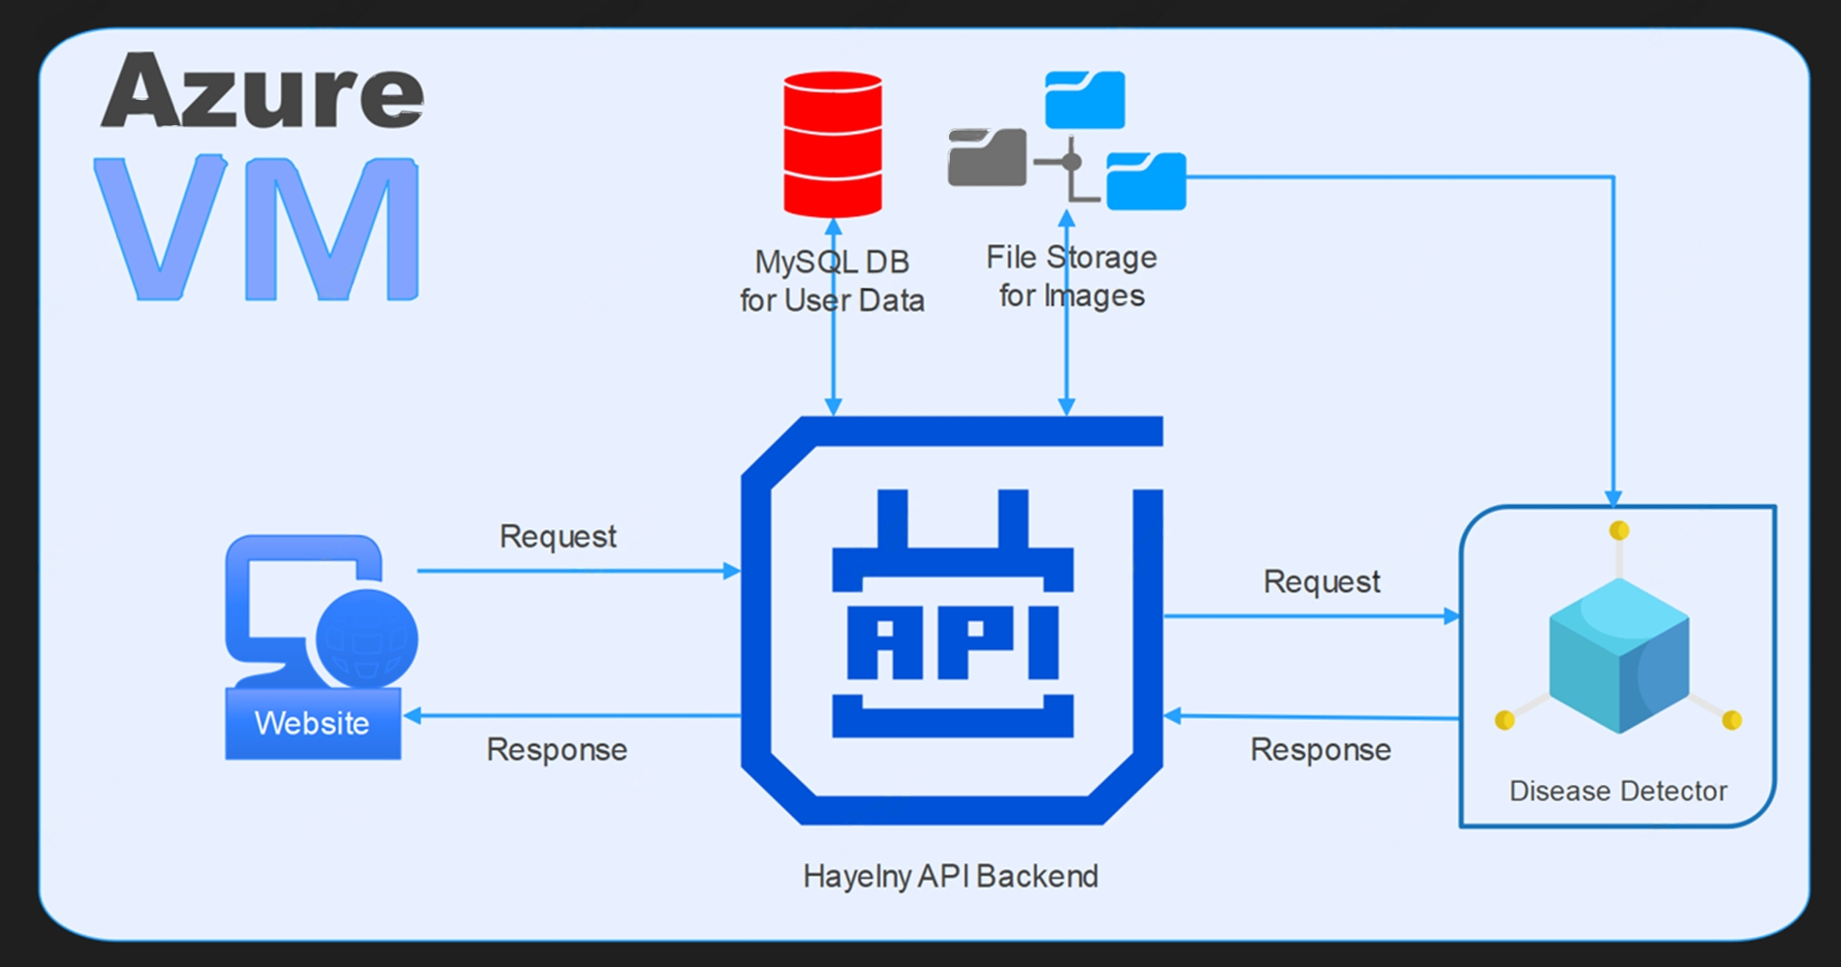

Slide 31
10
Methodologies and Techniques

Slide 32
Methodologies and Techniques
1- Data loading and preprocessing: The dataset is loaded using a class from the torchvision library. Data transformations such as resizing images to a specific size and converting them to tensors are applied using the transforms module
2 - The directory structure of the dataset is explored, which returns the class labels.
3 - Data loaders for the training and testing datasets are created using the Data Loader class. The dataset can be iterated over in batches, with the data shuffled and loaded in parallel. The datasets . Image Folder class and the previously defined transformations are used to create the training and testing data loaders.
4 - The mean and standard deviation of the training dataset are calculated. These statistics are used to normalize the image data
5 - We used Transfer Learning technique with ResNet18 model as the base model, and a new fully connected layer is substituted to adapt it to the binary classification task. The model parameters are optimized using the Adam optimizer, and a learning rate scheduler is used to adjust the learning rate during training. The binary cross-entropy loss function is defined using nn.BCEWithLogitsLoss.
6 - weight tensor is created based on based on quantity of each class in the training dataset. This tensor is utilized to assign higher weights to minority class samples during training
7 - The model is trained using a loop that iterates over the training dataset. In each iteration, the model parameters are updated using backpropagation and the calculated gradients. The model weights are adjusted based on the computed loss value. The learning rate scheduler is also updated according to the validation loss.
8 - The test dataset is evaluated by iterating over the test data loader. Predictions are generated using the trained model, and the performance metrics are calculated

Slide 33
11
System Requirements (S/W and H/W Tools)

Slide 34
System Requirements (S/W and H/W Tools)
Details

Slide 35
12
Results and Outcomes

Slide 36
Results and Outcomes
Details

Slide 37
13
System Validation

Slide 38
System Validation
Details

Slide 39
14
Conclusion

Slide 40
Conclusion
In conclusion, we find that AI provides a strong opportunity for use in low-income countries as an alternative to trained medical personnel, not ignoring the inherent limitations of our model and all AI models in general such as the trust problem and ethical considerations. Lastly we recommend that more work and resources be allocated to this type of research, and future research to attempt to tack the limitations found in this paper.

Slide 41
15
References

Slide 42
References
[1] “Radiology Facing a Global Shortage.” https://www.rsna.org/news/2022/may/Global-Radiologist-Shortage (accessed Nov. 09, 2022).
[2] “WHO consolidated guidelines on tuberculosis: module 2: screening: systematic screening for tuberculosis disease.” https://www.who.int/publications-detail-redirect/9789240022676 (accessed Nov. 09, 2022).
[3] Z. Meng, L. Meng, and H. Tomiyama, “Pneumonia Diagnosis on Chest X-Rays with Machine Learning,” Procedia Comput. Sci., vol. 187, pp. 42–51, Jan. 2021, doi: 10.1016/j.procs.2021.04.032.
[4] S. Hwa, A. Bade, M. Hijazi, and M. Jeffree, “Tuberculosis detection using deep learning and contrastenhanced canny edge detected X-Ray images,” IAES Int. J. Artif. Intell. IJ-AI, vol. 9, p. 713, Dec. 2020, doi: 10.11591/ijai.v9.i4.pp713-720.
[5] S. Guefrechi, M. B. Jabra, A. Ammar, A. Koubaa, and H. Hamam, “Deep learning based detection of COVID-19 from chest X-ray images,” Multimed. Tools Appl., vol. 80, no. 21–23, pp. 31803–31820, 2021, doi: 10.1007/s11042-021-11192-5.
[6] S. Kazemzadeh et al., “Deep Learning Detection of Active Pulmonary Tuberculosis at Chest Radiography Matched the Clinical Performance of Radiologists,” Radiology, p. 212213, Sep. 2022, doi: 10.1148/radiol.212213.
[7] J. D. Schroeder et al., “Prediction of Obstructive Lung Disease from Chest Radiographs via Deep Learning Trained on Pulmonary Function Data,” Int. J. Chron. Obstruct. Pulmon. Dis., vol. 15, p. 3455, 2020, doi: 10.2147/COPD.S279850.

Slide 43
Thank You

